Slide 1

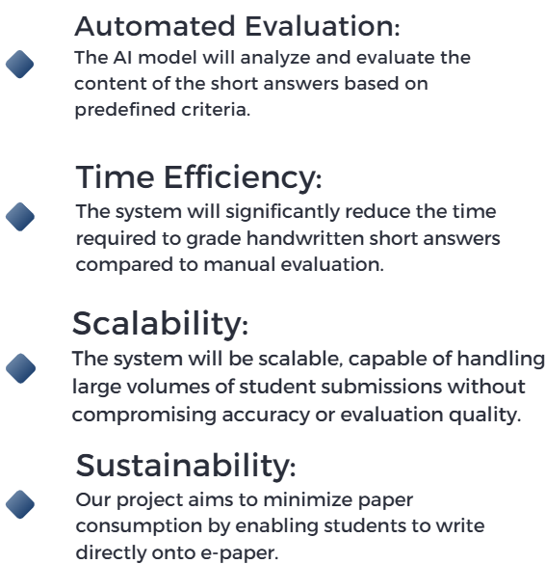
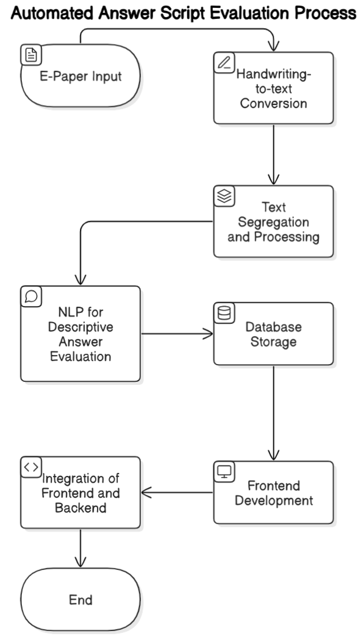
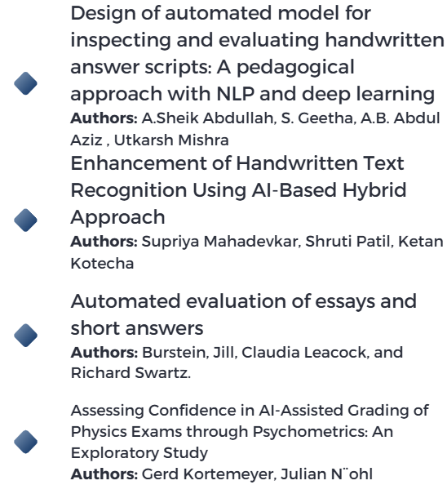
RV College of Engineering, Bengaluru – 560059.
Go, change the world
Title: AI-Assisted Exam Evaluator
Theme: Artificial Intelligence
Abhijat Bhat | Aditya Narayan | Aditya Bhandari | Shreyash Bhaskar Patil
1RV23CS007 | 1RV23CS019 | 1RV23CD003 | 1RV23CD052
Introduction
Tools used
Artificial Intelligence (AI) is transforming education, particularly in examination evaluation. Traditional methods are time-consuming, prone to bias, and struggle with scalability. AI addresses these issues by automating evaluation, ensuring accuracy, and providing valuable insights into student performance. This presentation explores the benefits, challenges, and future potential of AI-assisted examination systems.
Hugging face transformers:
Gramformer (for grammar correction)
Spelling corrector transformer (for spelling correction)
BERT transformer (for sentence embeddings)
External python Libraries:
SpaCy (basic natural language processing)
SciKitLearn (for cosine similarity)
Groq (extended language processing)
PDF2Image (converting PDF to its respective images)
PaddleOCR (performing OCR on the PDF)
Pandas (dataset manipulation)
Problem Definition
Traditional exam evaluation is slow, inconsistent, and lacks scalability, leading to delays and errors. A more efficient, accurate, and scalable solution that leverages AI technology is needed to meet modern education demands.
Results and Discussions
Objectives
The tool provides accurate results for descriptive answers based on grading rubrics and provided answers. OCR inaccuracies are mitigated using NLP for context-based predictions. Future plans include integrating a robust OCR model to evaluate answers with equations and diagrams.
To automate the examination evaluation process for improved efficiency and accuracy.
To provide scalable solutions for large-scale education systems.
To deliver personalized feedback and insights for enhanced student learning.
To reduce the time and effort required for manual evaluation by educators.
Conclusions
Methodology
References

